Slide 2
Oil Palm Cultivation
Module 3: Introduction to Cultivation and Processing Management in Agribusiness
Unit 1: Oil Palm Cultivation
Botanical Name: Elaeis guineensis

Slide 3
Learning Objectives
Explain environmental requirements
Describe propagation & nursery management
Identify agronomic practices
Recognize fruit types and varieties
Explain harvesting process

Slide 4
Environmental Requirements
Temperature: 25–34°C
Rainfall: 2000–2500 mm annually
Soil pH: 5.0–6.0
Deep, fertile, well‑drained loamy soils

Slide 5
Stages of Cultivation
Propagation
Nursery Management
Field Establishment
Agronomic Practices
Harvesting

Slide 6
Propagation
Oil palm propagated mainly by seeds
Dormancy broken at 40°C for 70–80 days
Hybrid Tenera (Dura × Pisifera) preferred
Nursery Management
Seedlings raised 12–15 months
Use perforated black polythene bags
Apply fertilizer (56 g/seedling)
Mulching, shading, watering, pest control

Slide 7
Field Establishment
Clear vegetation and prepare land
Spacing: 9 m × 9 m triangular
Approx. 143 palms per hectare
Plant at beginning of rainy season
Agronomic Practices
Weeding
Fertilizer application (NPKMg 12:12:17:2)
Pruning
Pest and disease control

Slide 8
Common Pests and Diseases
Bagworms
Rhinoceros beetles
Red spider mites
Rodents
Freckle disease
Ganoderma trunk rot

Slide 9
Harvesting
Begins 3–4 years after planting
Loose fruits fall naturally
Fruit colour change
Fruit softening
Harvesting Tools
Chisel
Harvesting hook
Climbing rope
Mechanical harvesters

Slide 10
Oil Palm Products
Palm oil – food & cosmetics
Palm kernel oil – soap & baking
Palm kernel cake – livestock feed
Palm pressed fiber – biomass energy
Empty fruit bunches – organic fertilizer

Slide 11
Fruit Types
Nigrescens
Virescens
Albescens
Mantled fruits
Parthenocarpic fruits
Varieties (Species Types)
Dura – thick shell
Pisifera – thin/no shell
Tenera – high oil yield (recommended)

Slide 12
Cropping System
Intercrop with cassava, maize, melon, sweet potato (first 4 years)
Improves income
Supports better farm management

Slide 13
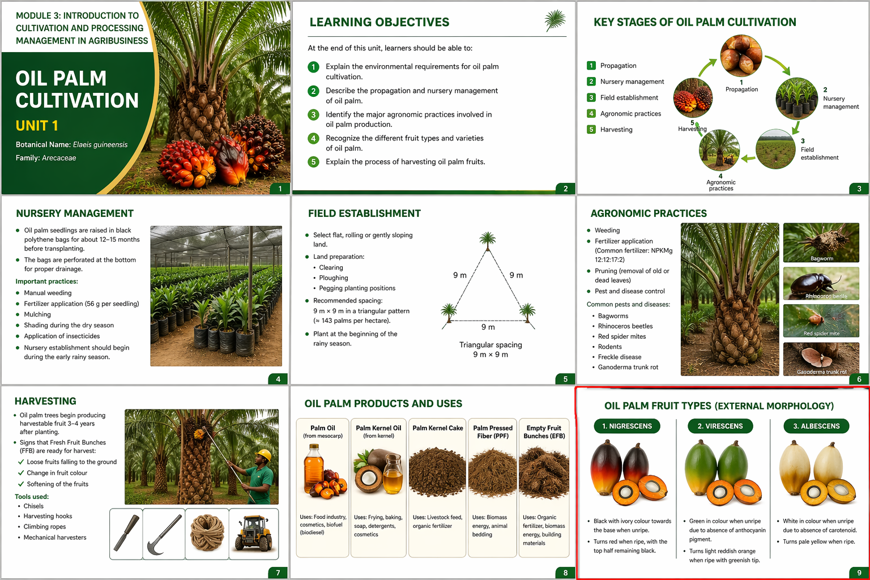

Slide 14
Conclusion
Oil palm is a major tropical oil crop
Requires proper nursery & field management
Timely harvesting improves yield
Produces valuable industrial by‑products

